Slide 1
Medical Emergencies
By Laura G

Slide 2
Medical emergencies
paramedics
receptionist
patient
stethoscope
ambulances

Slide 3
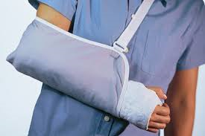
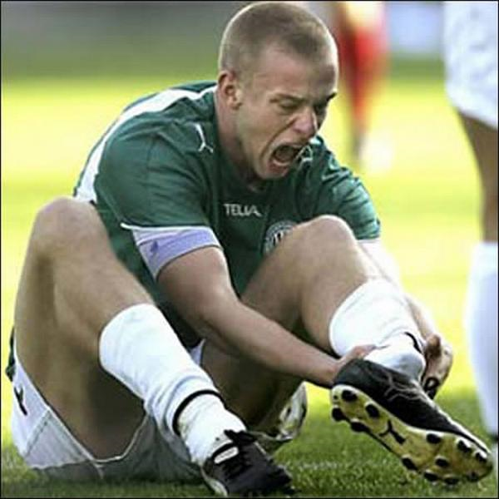
Injuries!!
Broken leg
Broken arm
Sore neck

Slide 4
Grammar Point…Simple Past
What happened?
We use the simple past tense to describe what happened.
Ex. 1 I broke my leg. (verb=break)
Ex. 2 I broke my arm.(verb=break)
Ex. 3 I had sore neck.(verb= have)
Ex. 4 I hurt my head.(verb=hurt)
Ex. 5 I drank poison.(verb=drink)
CAREFUL: If the past is irregular, it does not use –ed.

