Slide 1
Sports
By Adela and Erendira

Slide 2
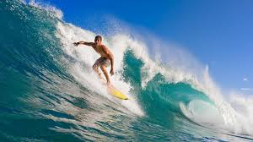
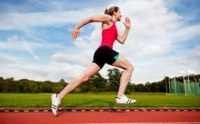
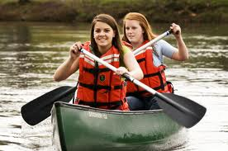
Actions
surfing
running
Playing basketball
canoeing
Rowing

Slide 3
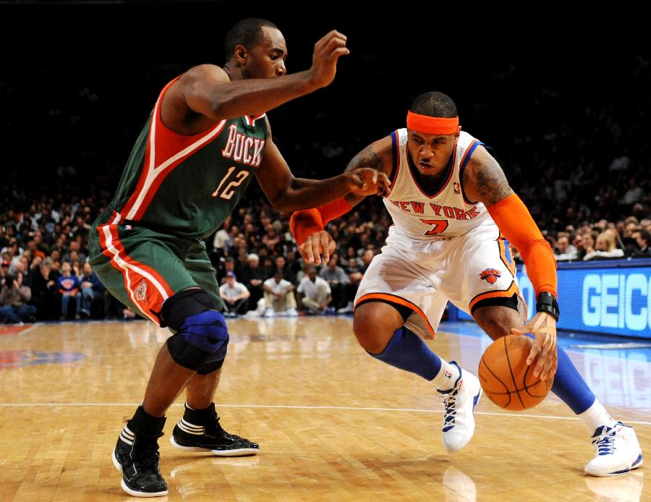
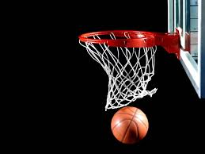
What you need for playing basketball?
Referee
players
net
court
ball
sneakers

Slide 4
Grammar Point…Activities with -ing
Gerunds
The –ing word of a progressive verb is called the gerund.
We use it to name an action or sport. Ex. “playing tennis”
When we use a gerund, it acts like a noun. Ex. “Playing tennis is fun.”
Ex. 1 Running is good for your health.
Ex. 2 Canoeing is boring.
Ex. 3 Surfing is fun.
Ex. 4 Rowing is hard.
Careful…
The verb “is” goes AFTER the gerund, but when someone is doing an action, it goes before.

