Slide 1
Jobs
By Marlen and Lidia

Slide 2
Occupations
carpenter
doctor
lawyer
beautician
chef
policeman

Slide 3
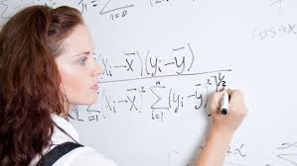
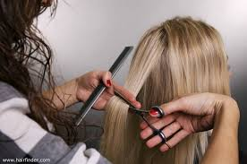
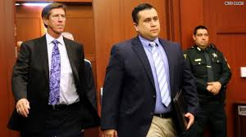
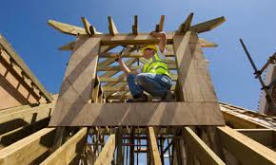
Actions
teaches
cuts
defends
cooks
builds

Slide 4
Grammar Point…subject-verb agreement
What does he do?
We only add –s to words in third person singular (he/she/it)
Careful…
This is only for present tense.
For words ending with –s, -z, -ch, or –sh, we add -es
Example 1 | defend
I defend You defend He/she/it defends | We defend They defend
Example 2 | Cut
I cut You cut He/she/it cuts | We cut They cut
Example 3 | Teach
I teach You teach He/she/it teaches | We teach They teach

