Slide 1
Nutrition
By Sandra and Maria Elena

Slide 2
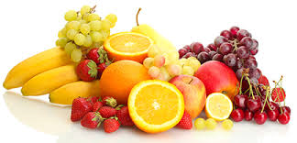
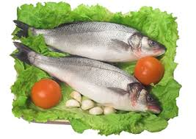
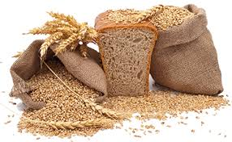
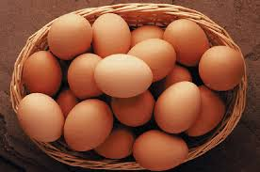
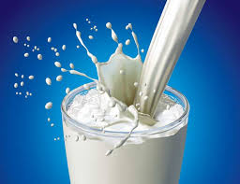
Healthy food
Fruits
Fish
Wheat
Eggs
Milk

Slide 3
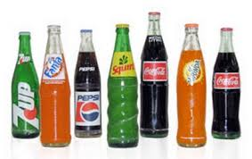
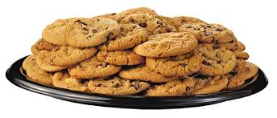
Unhealthy food
Frozen dinners
Ice cream
Candy bar
Soda
Cookies

Slide 4
Grammar Point…Count/Noncount Nouns
What is the difference?
A count noun is one that can be expressed in plural form, usually with an "s." For example, “apple” “apples”.
Use “a” or “an” Ex. I have a banana and an orange for breakfast.
Use “any”, “some” Ex. I have some eggs for breakfast.
Use “many” Ex. She has many cookies from the children.
Use “few” Ex. I have few fishes from the dinner.
A noncount noun is one that usually cannot be expressed in a plural form. For example, "milk”. Usually, you can't say, "He had many milks.“
Don’t use “a” or “an” because they mean “one”.
Use “any”, “some” Ex. I don’t like any ice cream. Do you like any ice cream?
Use “much” Ex. She likes to drink much soda.
Use “little” Ex. I like a little tea.
Careful…
“Any” and “some” can be confusing because they work for count and noncount nouns.

