Slide 1
Clothes
By Vanesa and Alejandra

Slide 2
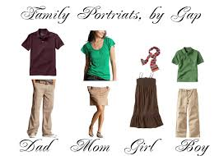
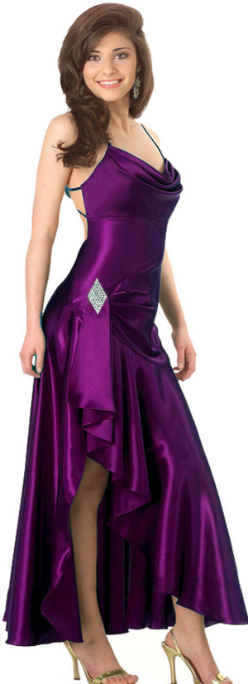
Clothes
blouse
scarf
shirt
shirt
Dress
pants
skirt
Shoes

Slide 3
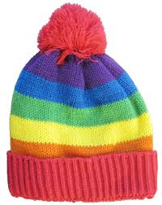
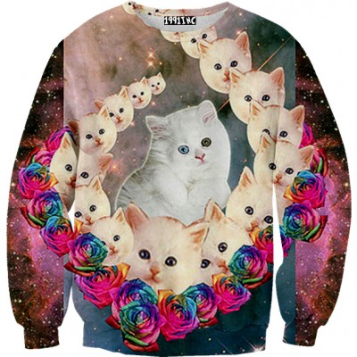
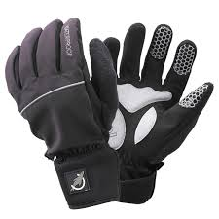
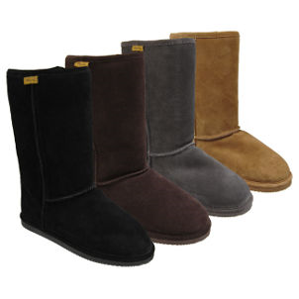
Winter clothing
hat
sweater
gloves
ear muffs
boots

Slide 4
Grammar Point…Irregular Past
How do you say it in the past?
When I describe the past tense, I usually add –ed, but some words are NOT regular.
Ex. Today my nail breaks. Yesterday my nail broke.
Ex. To day I have a headache. Yesterday I had a headache.
Ex. Yesterday I made beef soup.
Ex. I had an appointment .
Ex. Yesterday I bought gloves.
Ex. Yesterday I came to school.
Careful…
Sometimes the present and the past are the same word.
Ex. Yesterday I put on a jacket.

