Slide 1
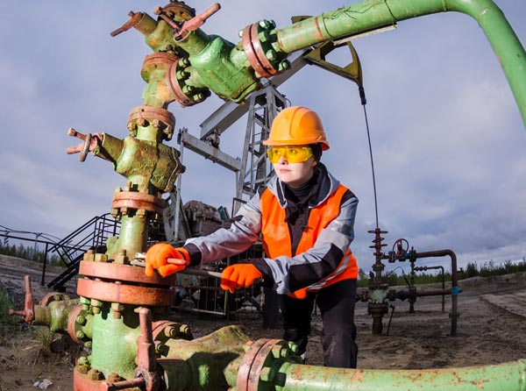
I WILL…
PETROLEUM ENGINEER

Slide 2
STEP 1

Slide 3
STEP 2

Slide 4
STEP 3

Slide 5
STEP 4

Slide 6
STEP 5

