Slide 1
Our Community
Where is …?

Slide 2
What is it for?
Who works there?
Where is it?
When is it open?
How do we use it?

Slide 3
What is it for?
Who works there?
Where is it?
When is it open?
How do we use it?

Slide 4
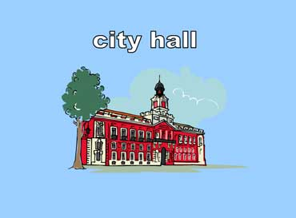
What is it for?
Who works there?
Where is it?
When is it open?
How do we use it?

Slide 5
What is it for?
Who works there?
Where is it?
When is it open?
How do we use it?

Slide 6
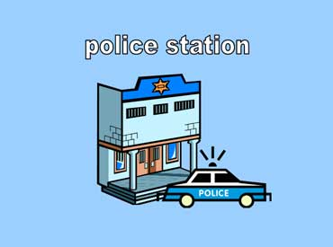
What is it for?
Who works there?
Where is it?
When is it open?
How do we use it?

Slide 7
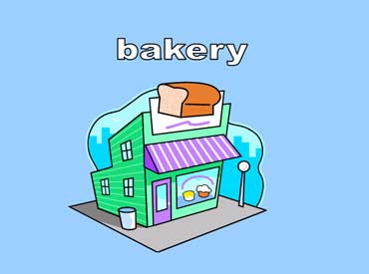
What is it for?
Who works there?
Where is it?
When is it open?
How do we use it?

Slide 8
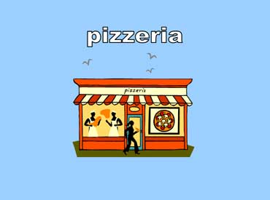
What is it for?
Who works there?
Where is it?
When is it open?
How do we use it?

Slide 9
What is it for?
Who works there?
Where is it?
When is it open?
How do we use it?

Slide 10
hospital
What is it for?
Who works there?
Where is it?
When is it open?
How do we use it?

