Slide 1
Grocery Store
By Berna and Estella

Slide 2
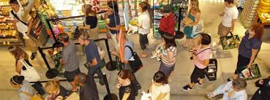
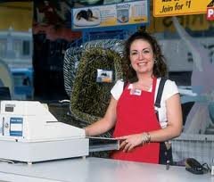
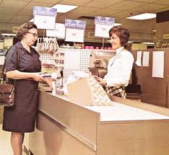
People in the Grocery Store
customer
cashier
Customer service representative

Slide 3
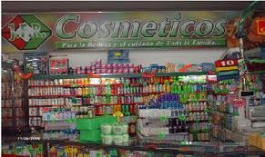
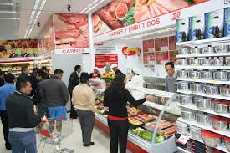
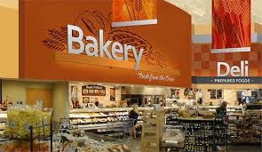
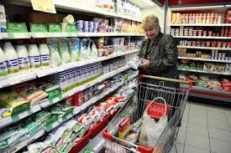
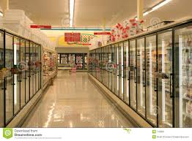
Departments and Aisles in the Grocery Store
Cosmetics department
Meat department
Dairy department
Bakery
department
Frozen aisle

Slide 4
Grammar Point…Present Progressive
What are you doing?
When I tell what is in process, I use a form of “to be” + verb + ing
Ex. I am explaining the sales.
Ex. 2 I am buying meat.
Ex. 3 We are looking for make-up.
Ex. 4 I am buying cakes.
Ex. 5 We are getting ice cream at the store .
Careful…
Make sure you conjugate “to be”
I am shopping We are shopping
You are shopping
He/she/it is shopping They are shopping

