Slide 1
Clothing
By Araceli and Araceli

Slide 2
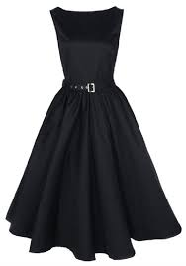
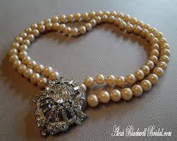
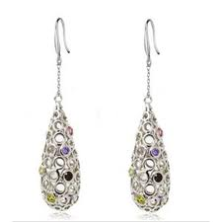
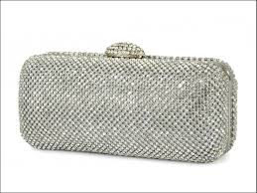
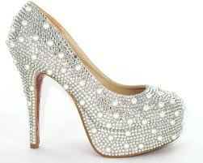
Formal Clothing
Cocktail dress
String of pearls
Pierced earrings
Clutch bag
High heels

Slide 3
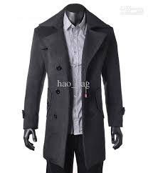
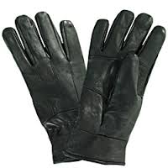
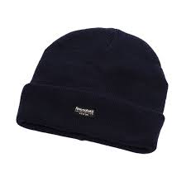
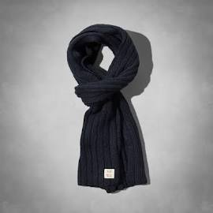
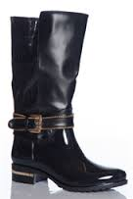
Winter Clothing
TRENCH COAT
GLOVES
SKI HAT
WINTER SCARF
RAIN BOOTS

Slide 4
Grammar Point…Adjectives then Nouns
In English, the adjective is before the noun when I use an action verb.
Careful…
If my sentence uses “to be” the adjective goes after the noun.
Noun + action + adjective + noun | Noun + “to be verb” + adjective
Ex. I bought a blue dress. | The dress is blue.
Ex. We bought a white string of pearls. | The string of pearls is white.
Ex. We bought new shoes. | The shoes are new.
Ex. We bought large gloves. | The gloves are large.
Ex. We bought a black hat. | The hat is black.
Ex. We bought a soft scarf. | The scarf is soft.

