Slide 1
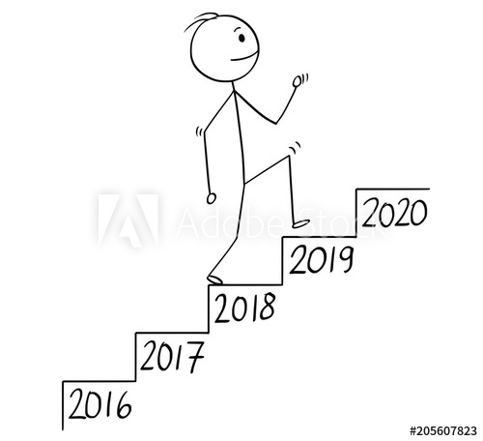
What is your goal?
What will you do?
How are you going to reach it?
What is the conclusion?

Slide 2
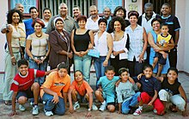
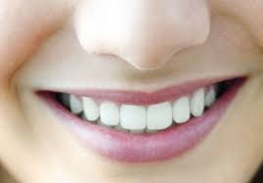
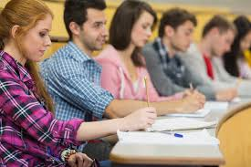
Chao Yu’s Goal
I will speak and write English.
After 4 years
And then
Every week
Every day
Monday through Thursday
Notes:
practice reading with Kari

Slide 3
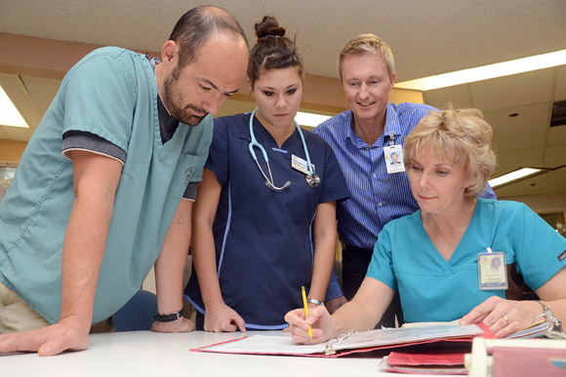
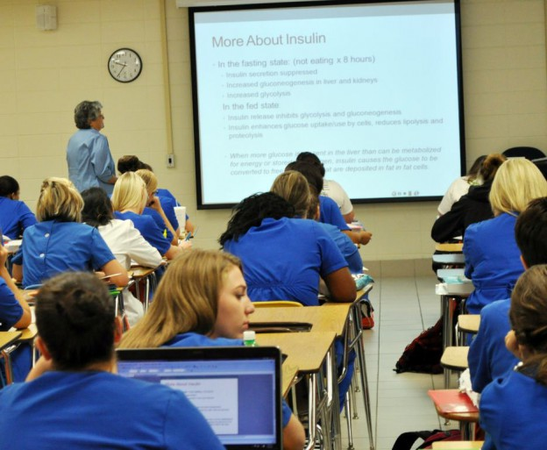
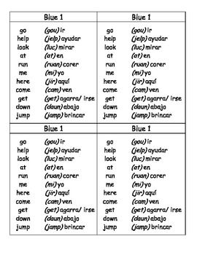
Maria’s Goal
I will get a nursing certificate.
And then
Also
By next year
Every day
Notes:
Read with Kari and show me paper.

Slide 4
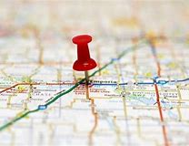
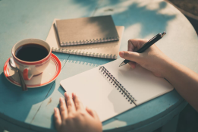
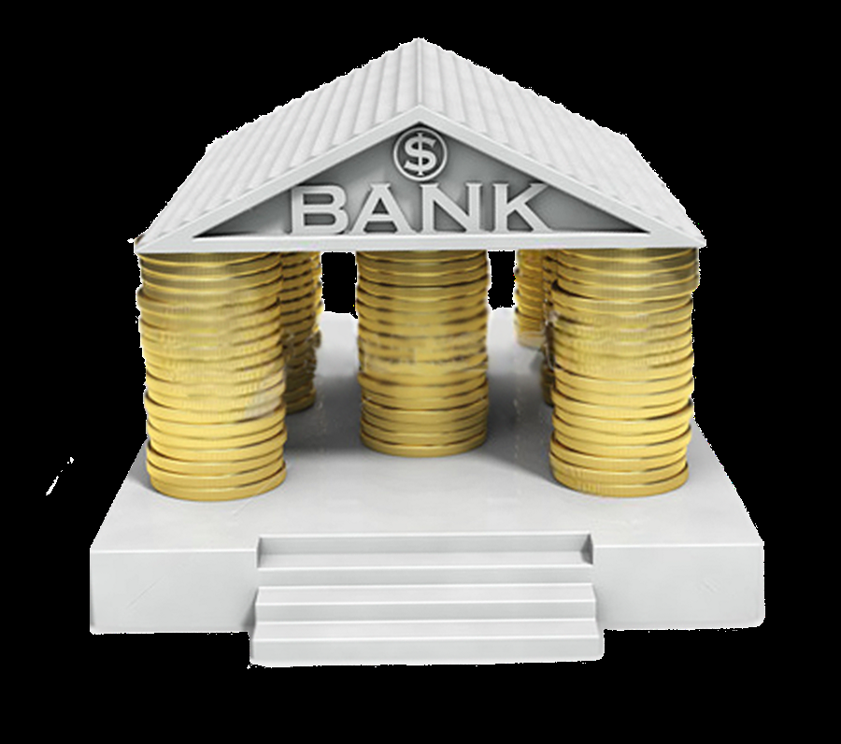
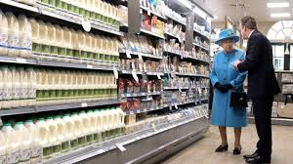
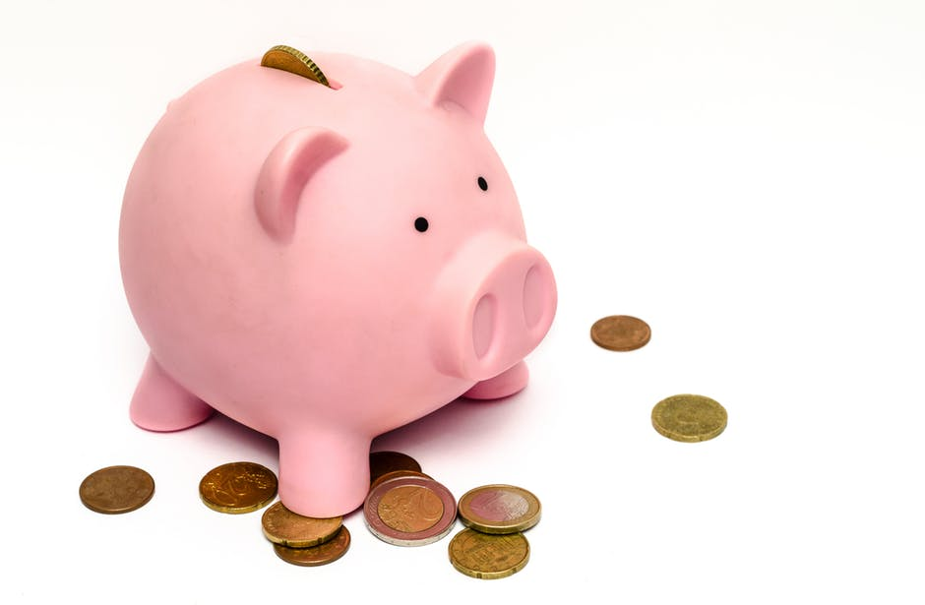
Aris’ Goal
I will open my own grocery store.
After that
By next year
Every week
Every day
Notes:
Write paper and read with Kari.

Slide 5
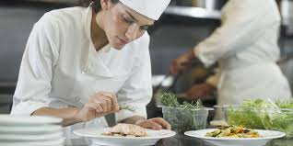
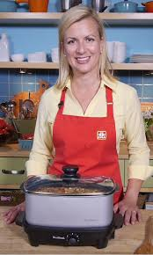
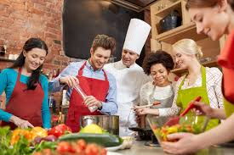
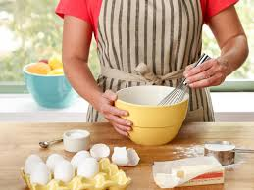
Katya’s goal
I will
After 4 years
Job at a restaurant
Cooking class
practice cooking at home
Notes:
need to check sentences and last picture.

Slide 6
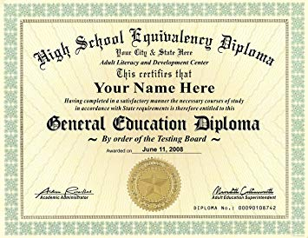
Blanca Goal
I will be a CPA.
And then
Also
By next year
Next
After that
Every day
Every week
Notes:
Remove extra time phrases. Check sentences. Add last 2 pics.

Slide 7
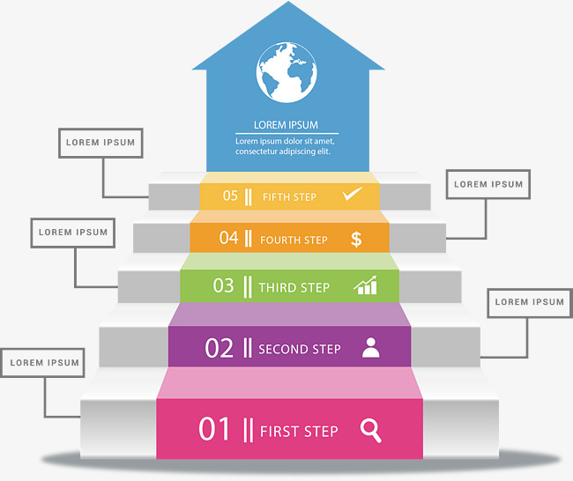
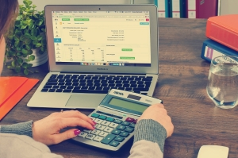
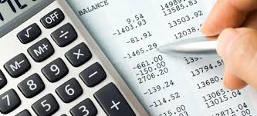
Veronica’s Goal:
I WILL BE AN ACCOUNTANT.
PRACTICE
ACCOUNTING CLASS
USE COMPUTER
ENGLISH CLASS
Notes:
Check sentences. Practice with Kari.

Slide 8
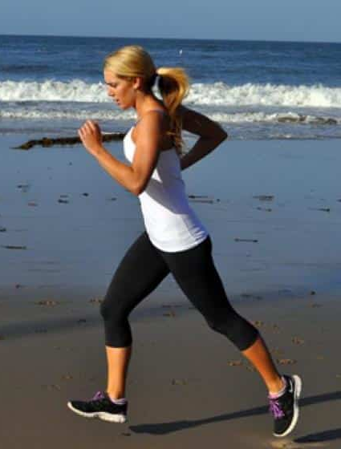
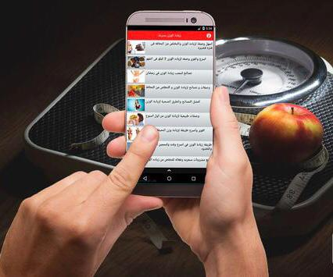
Fatima’s Goal
I will have a
perfect body.
After that
By next year
Every week
Every day
Notes:
Check sentences.

Slide 9
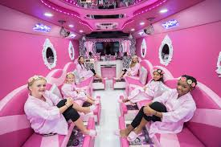
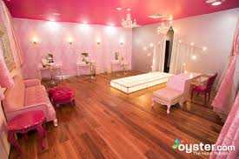
I WILL MAKE A SPA FOR A LITTLE GIRLS.
MARKET
LOOK FOR THE PLACE
CREDIT FROM BANK
IMAGINE PROJECT
Notes:
Check sentences and conclusion.

