Slide 1
Who is this?

Slide 2
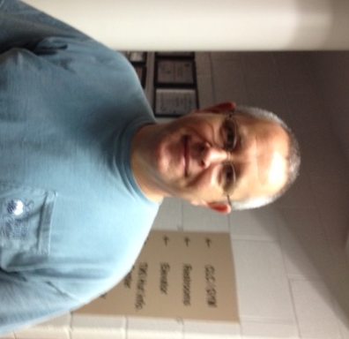
What is his name? What does he do?

Slide 3
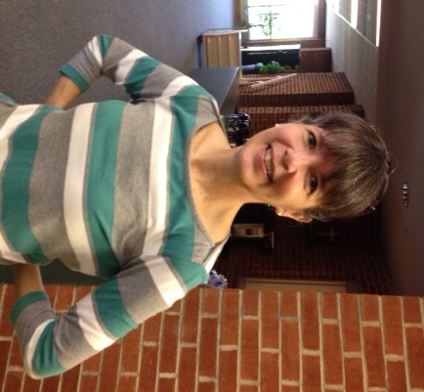
What is her name? What does she do?

Slide 4
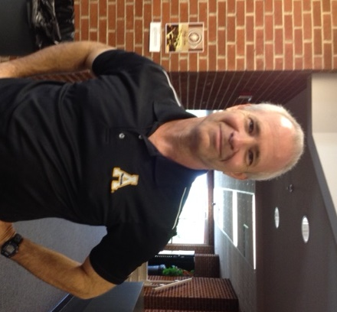
What is his name? What does he do?

Slide 5
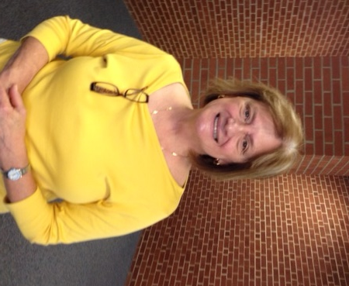
What is his name? What does he do?

Slide 6
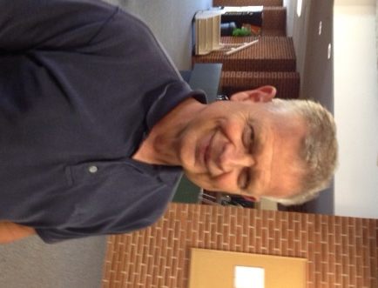
What is his name? What does he do?

Slide 7
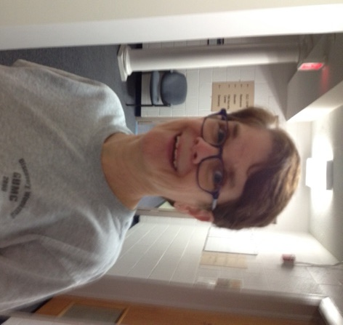
What is her name? What does she do?

Slide 8
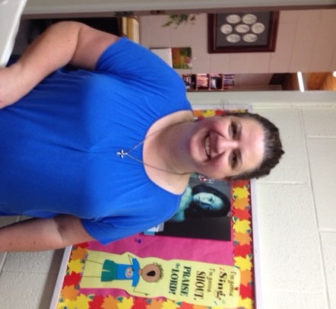
What is her name? What does she do?

