Slide 1
“would” If…what would you do?
?
?
?
If + past tense, would + base verb
If I came later, I would miss this great lesson.
?
?
?

Slide 2
If you wanted a job, what would you do?

Slide 3
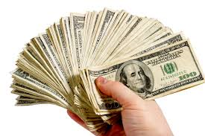
If you had one million dollars, what would you do?

Slide 4
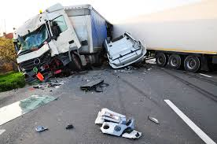
If you saw an accident, what would you do?

Slide 5
If you were a doctor, what would you do?

Slide 6
If you were president, what would you do?

Slide 7
If you could speak English perfectly, what would you do?

